Slide 1


WHAT ARE COMPONENTS ?
PART-6
PRESENTER: MOHAMMAD ADIL

Slide 2


Humble Request
Techno Verse YT
Heavenly Delicious

Slide 3
HEADER
Component
SIDEBAR
MAIN CONTENT
Component
Component
FOOTER
Component

Slide 4
COMPONENTS IN ANGULAR
Angular is a SPA framework, and a view is made of one or more component. An Angular component represents a portion of a view.
The component is the basic building block of Angular.
Generally, an interactive web page is made of HTML, CSS, and JavaScript. Angular component is no different.
Angular Component = HTML Template + Component Class + Component Metadata.
Components can be re-used.

Slide 5
Root Component
App Component
Custom Component 1
Custom Component 2
Custom Component 3

Slide 6
Generate Angular Component using Angular CLI
You can create files for a component manually or using the Angular CLI command. Angular CLI reduces the development time. So, let's use Angular CLI to create a new component.
Use the following CLI command to generate a component.
ng generate component <component name>
ng g c <component name>
All Angular CLI command starts with ng, generate or g is a command, component is an argument and then the name of the component.

Slide 7
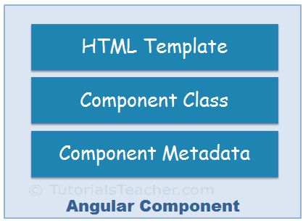
COMPONENTS IN ANGULAR

Slide 8
HTML Template
HTML template is nothing but a regular HTML code with additional Angular specific syntax to communicate with the component class.

Slide 9
Class
Essentially, a component class is a TypeScript class that includes properties and methods. Properties store data and methods include the logic for the component. Eventually, this class will be compiled into JavaScript.

Slide 10
Metadata
Metadata is some extra data for a component used by Angular to execute the component, such as the location of HTML and CSS files of the component, selector, providers, etc.
Metadata information provided by Component Decorator function.

Slide 11
Component Naming Convention
All the component files in Angular should follow the following format:
<component-name>.component.<file-type>
Example:
app.component.html
app.component.css
app.component.ts

Slide 12
Ways of calling components
There are 3 ways of calling our components inside app.component.html.
By using Custom Tag
By using Class selector
By using attribute

Slide 13
Important Points
All custom components are added inside app component.
Component is UI building block.
We can have multiple components to make up our website.
Components can be re-used.
Components are initiated using modules.
Components are the combination of HTML CSS and javascript.

Slide 14


